Slide 1
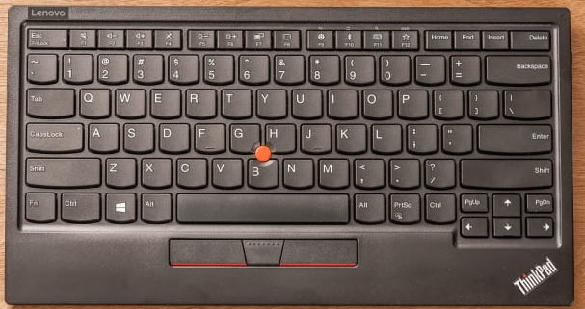
W – select front sail
R – restart game
F11 – full screen in/out
P – pause / play toggle
S – select main sail
X – track boat/world
Up arrow – release sails
? / - show this help info
Left Shift – hit rudder to the left
Right Shift – hit rudder to the right
Z – zoom in/out
Page Up – raise the keel
Page Down – lower the keel
Cntr – C – quit the game
Left arrow – rudder to left
Down arrow – pull sails
Right arrow – rudder to right

